Slide 1
CLIENT TESTIMONIALS: PAYERS

Slide 2
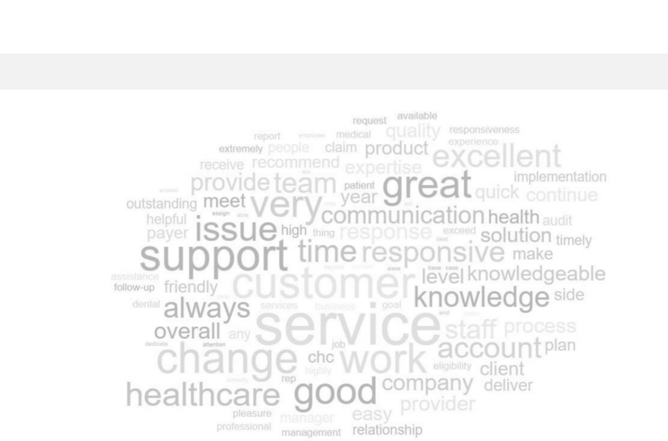
Client Testimonials: Payers
Our Key Values
Excellent Customer Service
Professionalism
Knowledge & Expertise
Quick Turnaround
Consistent Communication
*Word cloud based on client comments

Slide 3
Client Testimonials: Payers

Slide 4
Client Testimonials: Payers

Slide 5
Client Testimonials: Payers

Slide 6
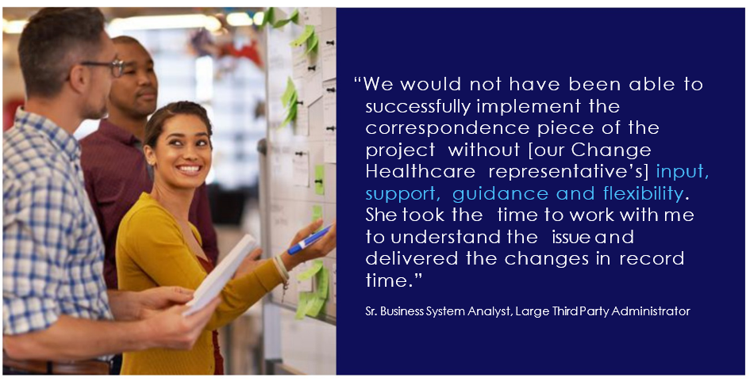
Client Testimonials: Payers

